Slide 1
Unit 5
Kernel Methods for Pattern Analysis
Prepared By
Arjun Singh Saud, Asst. Prof. CDCSIT

Slide 2
Statistical Learning Theory
Statistical learning theory is a framework for machine learning that draws from statistics and functional analysis.
It deals with finding a predictive function based on the data presented.
The main idea in statistical learning theory is to build a model that can draw conclusions from data and make predictions.

Slide 3
Statistical Learning Theory
With statistical learning theory, there are two main types of data:
Dependent Variable: A variable (y) whose values depend on the values of other variables (a dependent variable is sometimes also referred to as a target variable)
Independent Variables: A variable (x) whose value does not depend on the values of other variables (independent variables are sometimes also referred to as predictor variables, input variables, explanatory variables, or features)

Slide 4
Statistical Learning Theory
A statistical model defines the relationships between a dependent and independent variable.
For example, if the relationships between the size of the home (x) and the price of the home (y) is linear. We can define this relationship by using y = ax + b where a represents the gradient and b is the intercept.
If we suppose that the price (y) of the depends upon size (x1) of the home and the number of bathrooms (x2). We can define this relationship by using y = ax1 + bx2+c.

Slide 5
Support Vector Machine
Support Vector Machine or SVM is one of the most popular Supervised Learning algorithms, which is used for Classification as well as Regression problems. However, primarily, it is used for Classification problems in Machine Learning.
A support vector machine takes input data points and outputs the hyperplane (which in two dimensions it’s simply a line) that best separates the data points into two classes.
This line or hyperplane is the decision boundary: any data points that falls to one side of it is classified in one class and, and the data points that falls to the other of it is classified in another class.

Slide 6
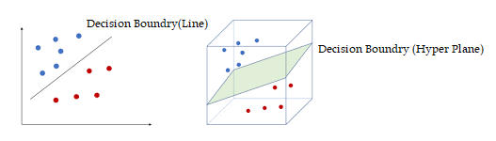
Support Vector Machine
Compared to newer algorithms like neural networks, they have two main advantages: higher speed and better performance with a limited number of samples (in the thousands).

Slide 7
Support Vector Machine
Support vectors are data points that are closest to the hyperplane and influence the position and orientation of the hyperplane.
To separate the two classes of data points, there are many possible hyperplanes that could be chosen.
SVM algorithm selects optimal hyperplane by choosing hyperplane with largest margin. Such hyperplane is called maximum marginal hyperplane (MMH).
Let H1 and H2 are planes that passes through support vectors and parallel to the hyperplane of decision boundary.

Slide 8
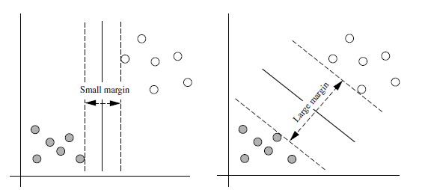
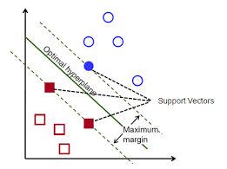
Support Vector Machine
Distance between plane H1 and the hyperplane should be equal to distance between plane H2 and the hyperplane. Margin is the distance between planes H1 and H2.

Slide 9
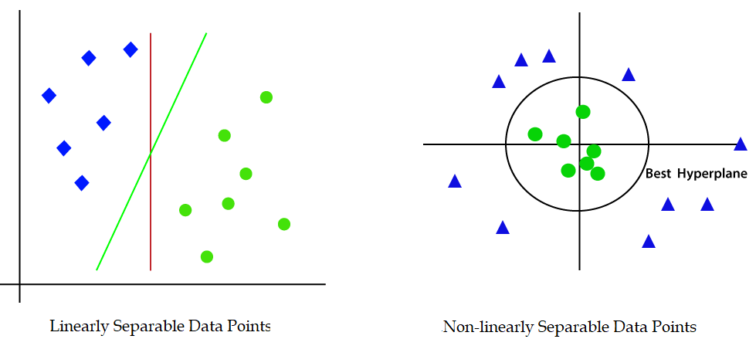
Support Vector Machine
Support Vector Machine(SVM) can be of two types: Linear SVM and Non-linear SVM.
SVM that is used to classify linearly separable data points is called linear SVM whereas the SVM that is used to classify non-linearly separable data points is called non-linear SVM.

Slide 10
Support Vector Machine
Non-linear SVM works in following two steps:
It transforms low–dimensional data points into high-dimensional data points, that are linearly separable, by using kernel-trick.
Then, it classifies data points using linear-hyperplane.
SVM algorithms use a set of mathematical functions that are defined as the kernel.
These functions are used to transform non-linearly separable low-dimensional data points into linearly separable high-dimensional data points.
Popular kernels are: Linear Kernel, Polynomial Kernel, Gaussian Kernel, Radial Basis Function (RBF), Sigmoid Kernel, etc.

Slide 11
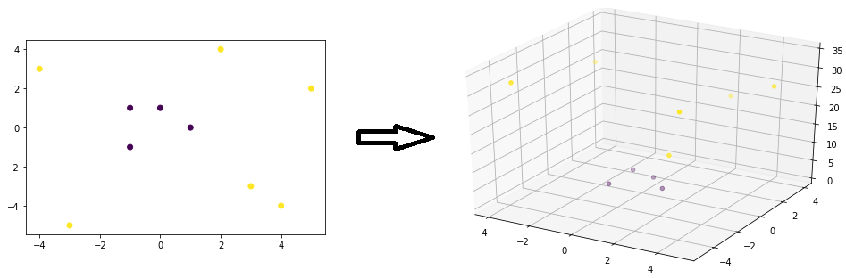
Support Vector Machine
Consider the following 2-D data points which are linearly inseparable. We can transform the data points into linearly separable data points by adding third dimension z=x²+y².

Slide 12
Support Vector Machine
Example
Consider following data points:
Positively Labelled Data Points:(3,1),(3,-1),(6,1),(6,-1)
Negatively Labelled Data Points:(1,0),(0,1),(0,-1),(-1,0)
Determine the equation of hyperplane that divides the above data points into two classes:

Slide 13
Support Vector Machine
Solution
Support vectors are
s1=(1,0), s2=(3,1), s3=(3,-1) why???
Augment support vectors with b=1
s1=(1,0,1), s2=(3,1,1), s3=(3,-1,1)

Slide 14
Support Vector Machine
Solution
Since there are three support vectors, we need to calculate three variables
Thus, three linear equations can be written as:
After simplifying above equations, we get

Slide 15
Support Vector Machine
Solution
After simplifying above equations, we get
Solving these equations, we get
Now, we can compute weight vector of hyperplane as below

Slide 16

Support Vector Machine
Solution
Thus,
=> equation of the hyperplane is:
w$.X+b=0$
$\left(1,0\right).(x,y) −2=0$
$x−2=0$

Slide 17
Support Vector Regression
Support Vector Regression (SVR) uses the same principle as SVM, but for regression problems.
The problem of regression is to find a function that approximates mapping from an input domain to real numbers on the basis of a training sample.
In Support Vector Regression, the straight line that is required to fit the data is referred to as hyperplane.

Slide 18
Support Vector Regression
Key hyperparameters that are used in Support Vector Regression are discussed below:
Hyperplane: Hyperplanes are decision boundaries that is used to predict the continuous output. The data points on either side of the hyperplane that are closest to the hyperplane are called Support Vectors. These are used to plot the required line that shows the predicted output of the algorithm.
Kernel: A kernel is a set of mathematical functions that takes data as input and transform it into the required form. These are generally used for finding a hyperplane in the higher dimensional space.

Slide 19
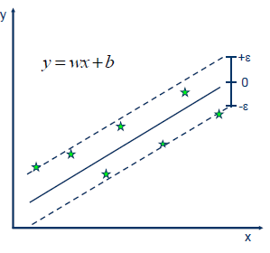
Support Vector Regression
Boundary Lines: These are the two lines that are drawn around the hyperplane at a distance of ε (epsilon). It is used to create a margin between the data points.
The basic idea behind SVR is to find the best fit line. In SVR, the best fit line is the hyperplane that has the maximum number of points.

Slide 20
Support Vector Regression
Unlike other Regression models that try to minimize the error between the real and predicted value, the SVR tries to fit the best line within a threshold value.
The threshold value is the distance between the hyperplane and boundary line.
The fit time complexity of SVR is more than quadratic with the number of samples which makes it hard to scale to datasets with more than a couple of 10000 samples.

Slide 21
Kernel Functions
Kernels are a way to solve non-linear problems with the help of linear classifiers. This is known as the kernel trick method.
Kernel Function generally transforms the training set of data so that a non-linear decision surface is able to transform to a linear equation in a higher number of dimension spaces.
Let us see some of the kernel function or the types that are being used in SVM:

Slide 22
Kernel Functions
Liner Kernel: Let us say that we have two vectors with name x1 and y1, then the linear kernel is defined by the dot product of these two vectors:
K(x1, x2) = x1 . x2
Polynomial Kernel: A polynomial kernel is defined by the following equation:
K(x1, x2) = (x1 . x2 + 1)^{d}
Where, d is the degree of the polynomial and x1 and x2 are vectors

Slide 23


Kernel Functions
Gaussian Kernel: This kernel is an example of a radial basis function kernel. Below is the equation for this.
Exponential Kernel: This is in close relation with the previous kernel i.e. the Gaussian kernel with the only difference is – the square of the norm is removed. The function of the exponential function is:

Slide 24

Kernel Functions
Laplacian Kernel: This type of kernel is less prone for changes and is totally equal to previously discussed exponential function kernel, the equation of Laplacian kernel is given as:

